Slide 1
Name : Saba project Name : Covid_19
Trainer : Sir Muhammad Ali
Course Name : Data Science
Date : 6_11_2025
Institute : I.M.C(TMK)

Slide 2
1. Dataset Structure
Code:
df.shape
print(df.columns)
Output:
Shape: (59, 10)
Columns:
['Country/Region', 'Last Update', 'Confirmed', 'Deaths', 'Recovered', 'Latitude',
'Longitude', 'Province/State', 'Active', 'Combined_Key']
Description:
The dataset contains 59 rows and 10 columns, representing COVID-19 statistics across different regions.
Each column holds specific information such as confirmed cases, deaths, recoveries, and location
details.

Slide 3
2.Data Types Identification
code:
df.dtypes
Output:
8 columns are of type object (categorical)
2 columns are of type float64 (numeric)
Description:
Most columns contain categorical data such as names or text, while a few represent numerical data used for quantitative analysis.

Slide 4
3.Dataset Information
Code:
df.info()
Description:
the dataset’s complete This command displays the dataset’s structure, non-null counts, and memory usage.
It confirms that some columns contain missing values and provides a quick overviess.

Slide 5
4. Missing Values
Code:
df.isnull().sum()
Output:
Total 233 missing values found across different columns.
Description:
This step identifies which columns have null or missing values. Handling these is important before any statistical or machine learning analysis.

Slide 6
5. Unique Country/Region Values
Code:
list(df['Country/Region'].unique())
Description:
Displays all the unique country or region
names in the dataset, helping to verify that
the geographical entries are accurate and
non-duplicated.

Slide 7
6. Unique Values per Column
Code:
df.nunique()
Description:
This gives the number of unique entries per column, helping detect duplicate categories or redundant data.

Slide 8
Conclusion
Rows and Columns: 59 × 10
Data Types: Mostly categorical with a few numeric columns
Missing Values: 233 found, need cleaning
Duplicates: None detected
Data Quality: Overall clean and consistent, suitable for further descriptive analysis

Slide 9
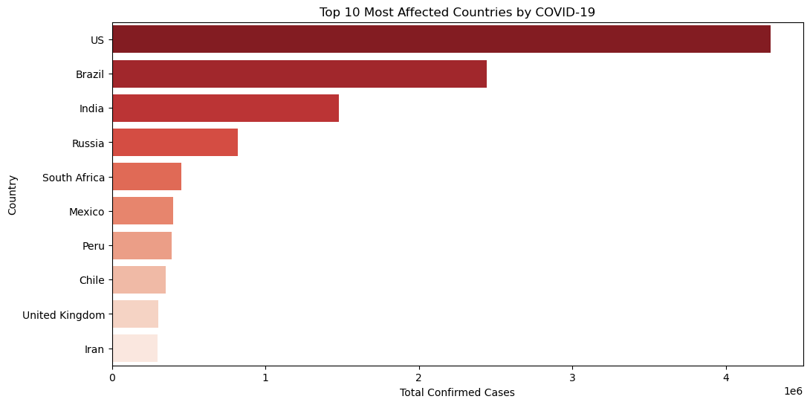
Top 10 Most Affected Countries by COVID-19

Slide 10
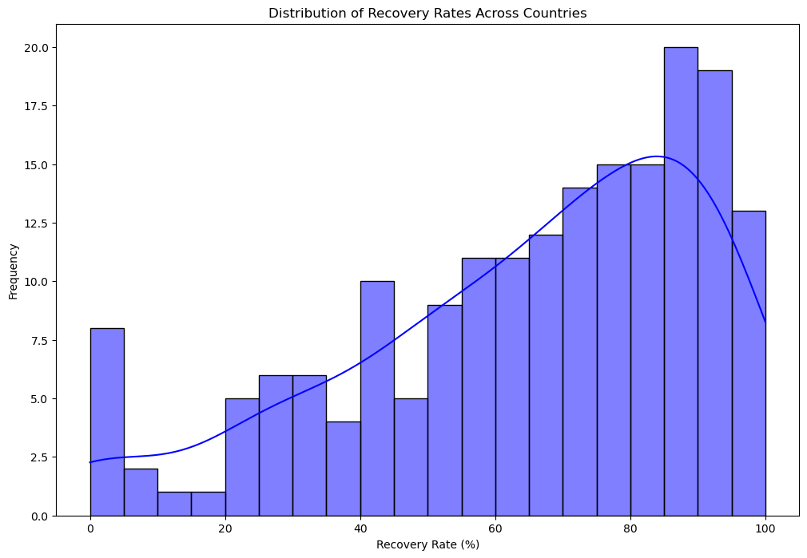
Distribution of Recovery Rates Across Countries

Slide 11
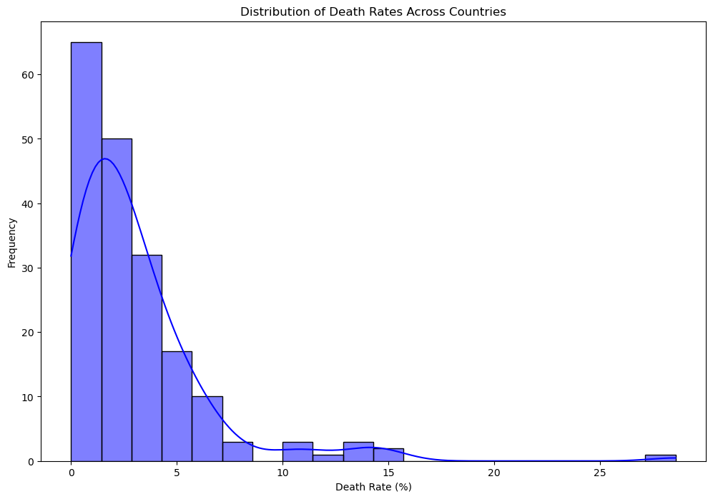
Distribution of Death Rates Across Countries

